Slide 1

Lokesh sharma

Slide 2
Introduction & OBJECTIVE
Optimal Location Identification: Analyzing data to identify potential countries and cities for opening new restaurants based on various factors such as market trends and customer preferences.
Success Factor Analysis: Examining key factors influencing restaurant success, including competition, customer ratings, and cuisine preferences, to inform strategic decisions.
Strategic Expansion Insights: Providing actionable insights for informed decision-making to ensure sustained growth and successful expansion in a dynamic market.
Data-Driven Recommendations: Offering recommendations rooted in comprehensive, data-driven analysis to support optimal restaurant placement and operational strategies.

Slide 3
DATA OVERVIEW
Restaurant Identification: Each establishment is uniquely identified by its distinctive IDs and names, allowing for precise tracking and differentiation within the dataset.
Geographical Insights: Detailed geographical information, including country codes, city coordinates, and addresses, provides a spatial context for analysing restaurant locations and their distribution.
Operational and Cost Dynamics: The dataset encompasses various operational details such as table bookings, online delivery options, and a range of cost-related attributes (price ranges, average costs, and currency information), offering a comprehensive view of the restaurant’s financial and service operations.
Customer Feedback and Temporal Data: It captures qualitative customer feedback through ratings and reviews, along with temporal data such as the opening year, adding a historical perspective to the restaurant's performance and evolution.

Slide 4
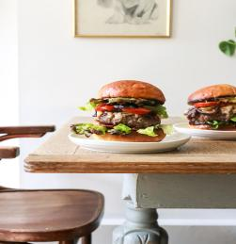

METHODLOGY
Streamlined Approach
Data Cleansing: Thorough cleanup, from city names to format consistency.
Enrichment Strategies: Infusing country descriptions and expanding our dataset.
Analytical Framework: Excel's pivot tables, IF functions, and statistical tools.
ToolBox Overview
Statistical Analysis: Uncovering trends and patterns.
Excel Functions: Pivot tables, LOOKUP, logical operators.
Balanced Precision: Technical insights in accessible language.

Slide 5
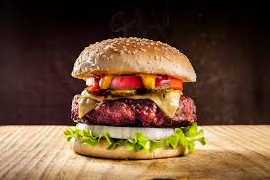
ANALYSIS OF OBJECTIVE QUESTIONS
Comprehensive Data Analysis: Explore and clean data, examine geographical distribution, and analyse pricing trends to gain a thorough understanding of the dataset and restaurant market dynamics.
Key Metrics and Insights: Investigate voter counts, average ratings, and specific conditions to uncover crucial insights and trends impacting restaurant success and performance.
Advanced Analytical Techniques: Utilize customized pricing analysis and array formulas for complex calculations, enabling detailed and nuanced insights into restaurant operations and financial metrics.

Slide 6




Suggested COUNTRIES
Analytical Criteria
Utilized Pivot tables with restaurant count and average ratings.
Applied filters for low competition and ratings below 4.
SRI LANKA
Strategic Insights
Identified regions with both low competition and potential for improvement in average ratings.
Focused on countries where market entry could yield substantial benefits.
Additional Insight
Found from Pivot tables that 7 countries have under 25 restaurants, and among them, 4 countries with ratings below 4 were selected, indicating less competition.

Slide 7




Country – SELECTED CITIES
K
Selected Cities in Recommended Countries
AUSTRALIA
SINGAPORE
Armidale
Balingup
Flaxton
Macedon
Penola
Analytical Criteria
Singapore
Utilized Pivot tables at the city level for detailed analysis.
Applied filters for low competition and ratings less than 4 within the suggested countries.
Insights
CANADA
SRI LANKA
Consort
Yorkton
Selected cities aligning with the overall country criteria.
Aimed for a balanced city selection strategy based on data analysis.
Colombo

Slide 8







ANALYZING FOOD EXPENDITURE IN TARGET REGIONS
Analytical Approach:
Utilized data from "Raw Data" sheet.
Applied SUMIF formula for aggregating expenditure on food.
Converted local currencies to USD for uniformity.
Visualization
Include a pie chart and table showcasing the expenditure breakdown for visual clarity
Total Expenditure on Food
Australia | ₹ 31,362
Canada | ₹ 8,922
Singapore | ₹ 1,91,573
Sri Lanka | ₹ 12,825

Slide 9



COMPETITOR ANALYSIS
FEW RESTAURANT NAMES - BIGGEST COMPETITORS
Analytical Criteria
Utilized Pivot tables at the restaurant level for detailed analysis.
Applied filters the suggested countries.
Bridge Road Brewers
1918 Bistro & Grill
Lake House
AL’ Frank Cookies
Ministry of Crab
The Sizzle
Insights
Selected restaurant having greater than 4 average rating as High competitor and below 3 average rating consider as Low competitor.
RESTAURANTS WITH LOW COMPETITORS
Star Buffet
Pier 70
Makansutra
Elite Indian Restaurant
Queen’s Cafe

Slide 10
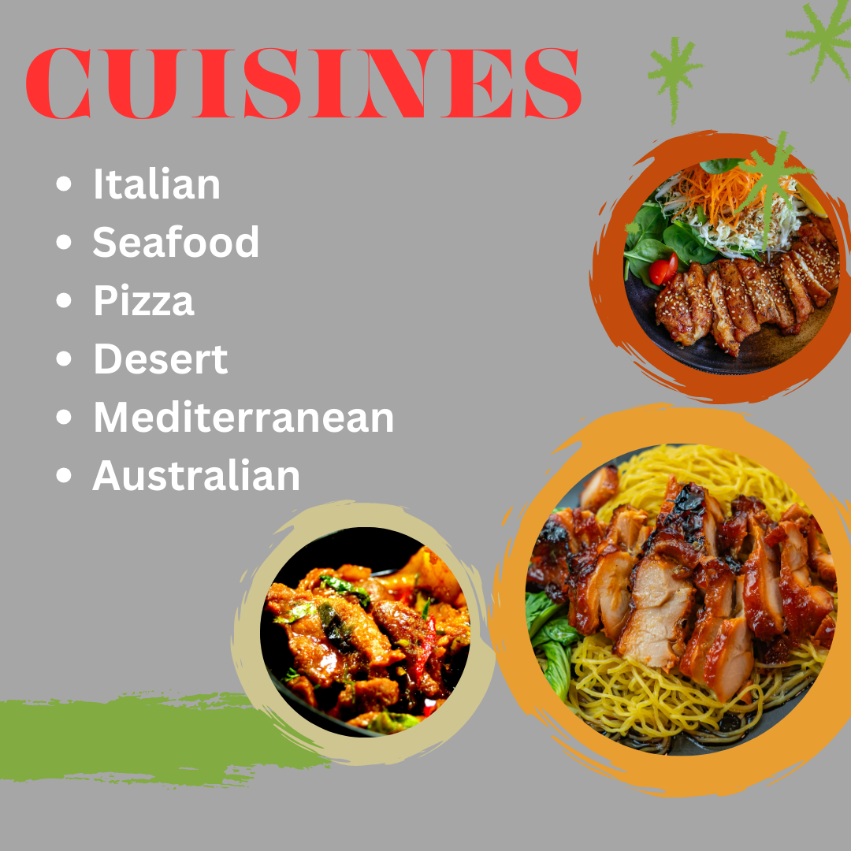
CUISINES with TOP RATINGS
These are the cuisines in the suggested four countries with high number of ratings.
These are some cuisines in all the four countries. It includes local food of that country and some other cuisines.
Top preference cuisines are seafood and Italian.

Slide 11


ONLINE DELIVERY /TABLE BOOKING
The selected four countries does not provide the option of online delivery / table booking.
This could be an opportunity for us. A market survey could be done to get insights about the preferences of the people about these.
Cost vs. Services: Explore if there is a relationship between the cost for two and the availability of table booking or delivery services. Analyze whether customers are willing to pay more for the convenience of these services.
Delivery Analysis
 | Online | Table Booking
Australia | 0 | 0
Canada | 0 | 0
Singapore | 0 | 0
Sri Lanka | 0 | 0

Slide 12
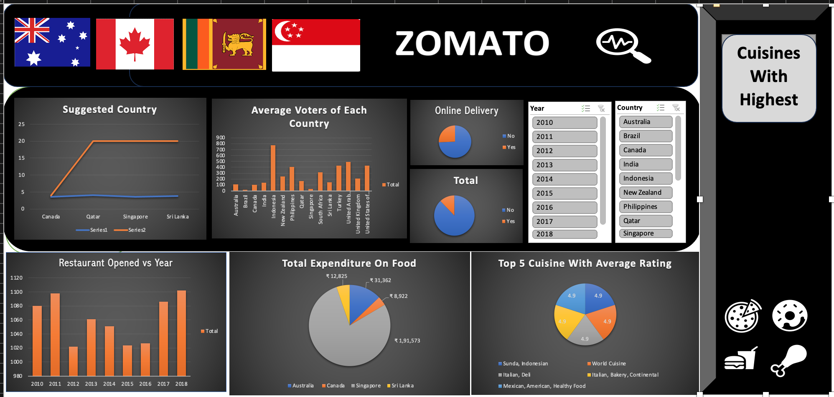
DASHBOARD

Slide 13
THANK YOU

